Slide 1
Disaster Relief Project Part 1
NAME: Gavin Wiehl (gtw4vx)
DATE: 3/1/2020
COURSE NAME AND NUMBER: SYS6018

Slide 2
Performance Metrics, 10x cross-validation:
RESULTS CONCLUSIONS
Method | Accuracy | AUC
KNN (K = 7 ) | 99.73% | 0.999
LDA | 99.36% | 0.997
QDA | 99.46% | 0.999
Logistic Regression | 99.57% | 0.986
Notes:
Results (30 points)
Fill in the % accuracy you get for each method (24 points; 0, 3, or 6 points each based on reasonableness of answer)
Fill in the value you used for K in KNN (0, 3, or 6 points based on reasonableness of answer)
For a 2-point bonus, add another column next to Accuracy and include the AUC (area under the curve) values for each method.
For an additional 2-point bonus, add another slide with ROC curves for all methods.

Slide 3
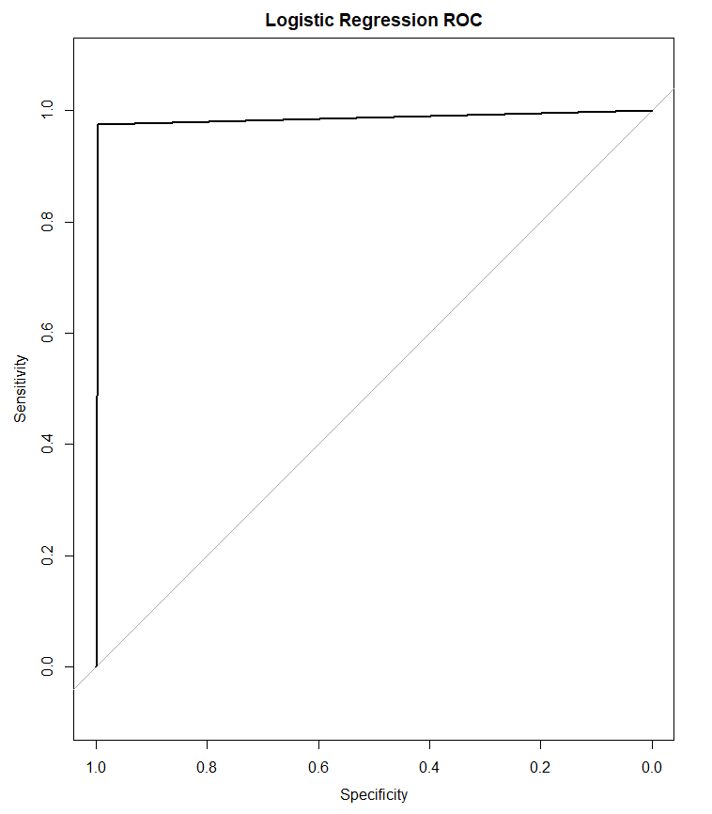
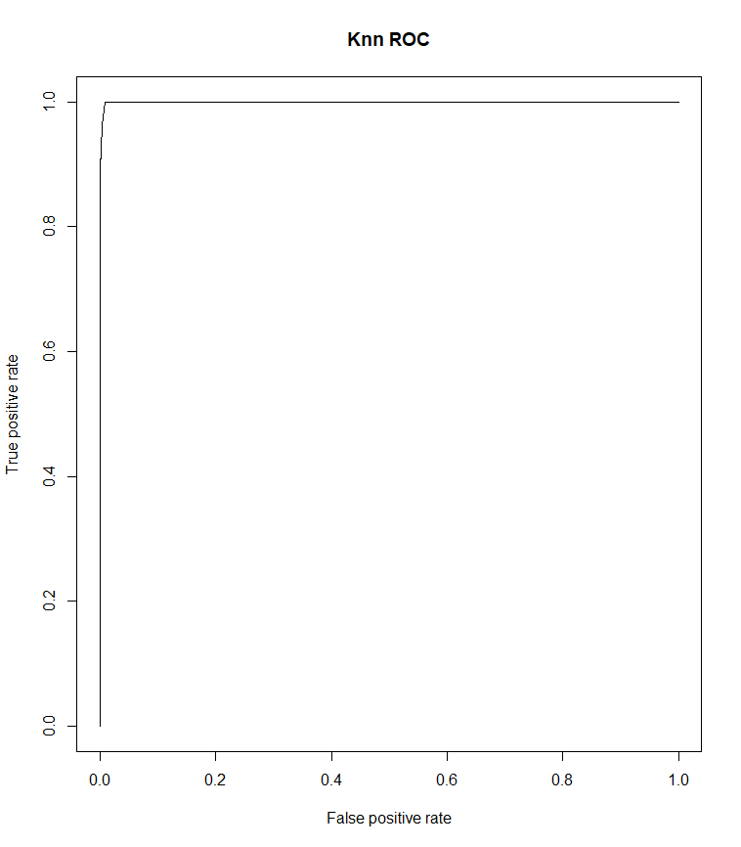
Logistic Regression Plot KNN ROC plot

Slide 4
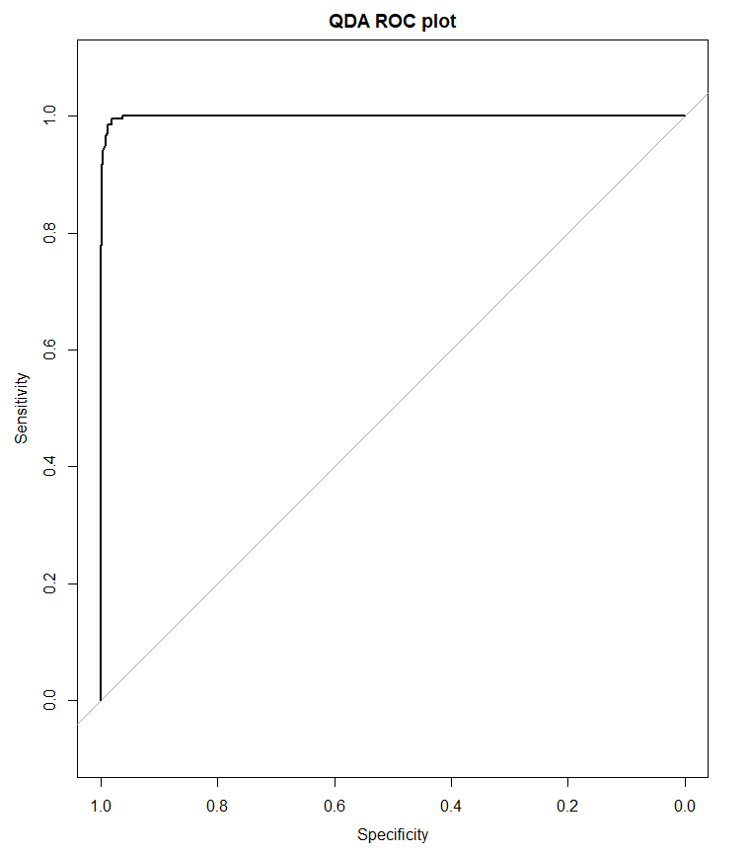

LDA ROC plot QDA ROC plot

Slide 5
Conclusions:
RESULTS CONCLUSIONS
I believe the KNN model should work the best. Not only is it’s 10-fold cross validated test accuracy the highest, but it also had the highest sensitivity rate at 96.17%. This is important since we want to maximize the number of blue tents found out of the total blue tents, in order to help as many people as we can. We don’t want to categorize a blue tent as something else and we should be more lenient when categorizing something else as blue tents.
Notes:
Conclusions (30 points)
State at least three conclusions.
One of your conclusions must be your determination of which algorithm works best. (10 points total; 0, 5, or 10 points each based on reasonableness of answer)
Your other conclusions should be observations you make based on the work on this project, such as the following: (0–20 points based on the quality of the conclusions)
Were there multiple adequate performing methods or just one clear best method?
Are there actions you recommend that might improve results?
Do these data seem particularly well-suited to one class of prediction methods, and if so, why?

Slide 6
Conclusions:
RESULTS CONCLUSIONS
Logistic regression also worked quite well, with an accuracy of 99.57% and a sensitivity rate of 91.03%. Both LDA and QDA worked well, but not as well as KNN and Logistic.
I found that including interaction terms of all three colors improved the results of the models. I think this is because the pixels are a set of three colors that combine to make other colors, thus it makes sense there would be interaction between the predictors in the models .
The data suites both Logistic Regression and KNN better than LDA or QDA, since the normality assumption does not hold with this data. The variances are also different, while this is not a problem for KNN or Logistic Regression.
Notes:
Conclusions (30 points)
State at least three conclusions.
One of your conclusions must be your determination of which algorithm works best. (10 points total; 0, 5, or 10 points each based on reasonableness of answer)
Your other conclusions should be observations you make based on the work on this project, such as the following: (0–20 points based on the quality of the conclusions)
Were there multiple adequate performing methods or just one clear best method?
Are there actions you recommend that might improve results?
Do these data seem particularly well-suited to one class of prediction methods, and if so, why?

